Slide 1

Signal Processing and Statistical Tools
In the Forensic Sciences

Slide 2
The Daubert Standard
Daubert (1993)- Judges are the “gatekeepers” of scientific evidence.
Must determine if the science is reliable
Has empirical testing been done?
Falsifiability
Has the science been subject to peer review?
Are there known error rates?
Is there general acceptance?
Federal Government and 26(-ish) States are “Daubert States”

Slide 3
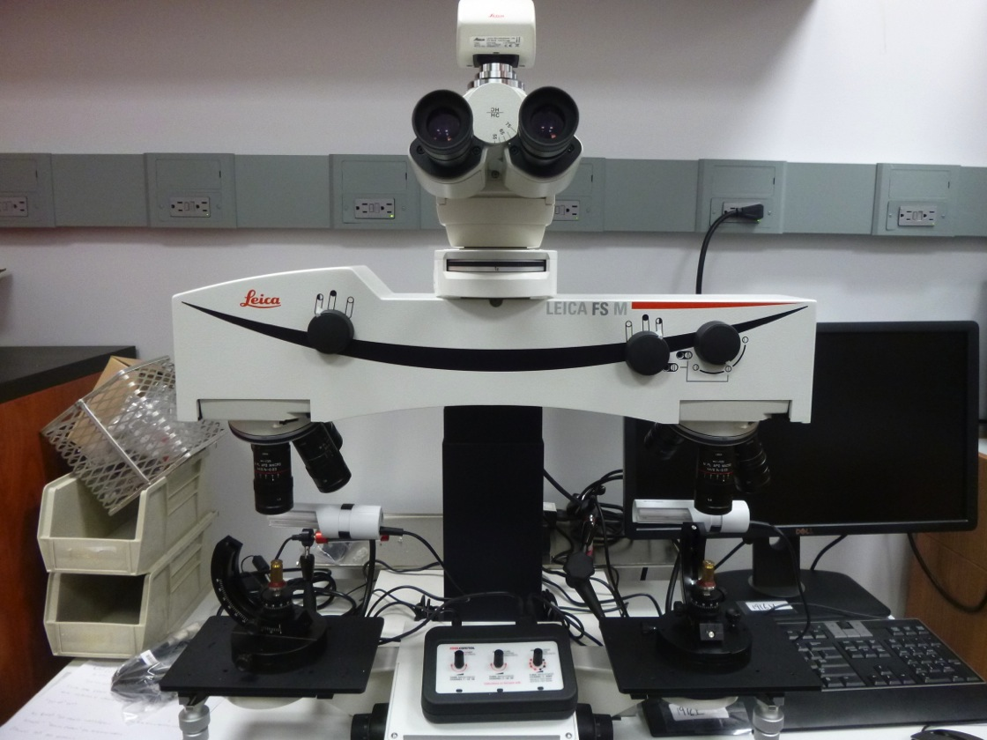
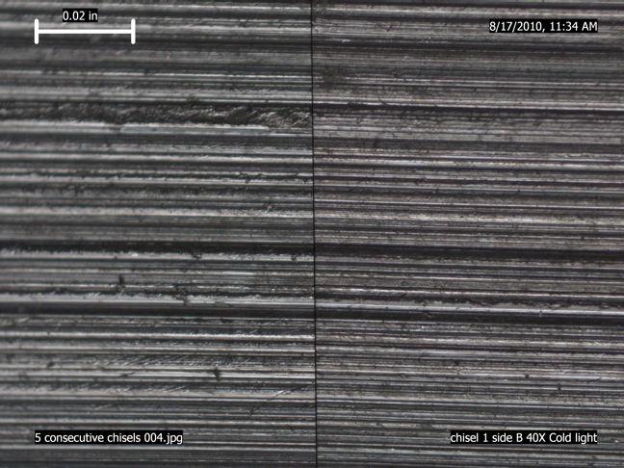
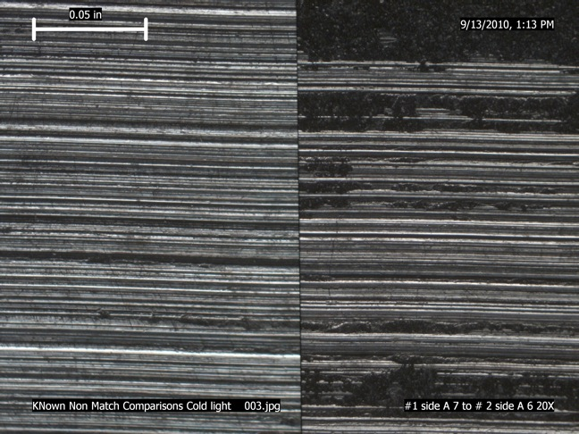
Tool Mark Comparison Microscope
KM
KNM
Jerry Petillo

Slide 4
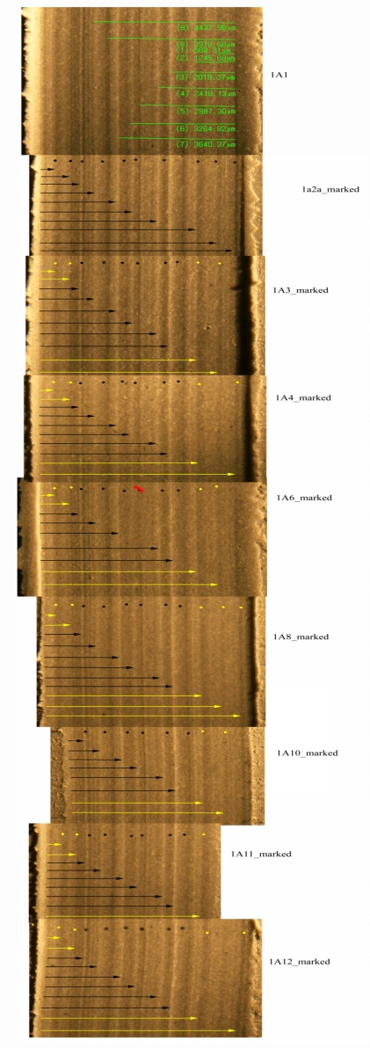
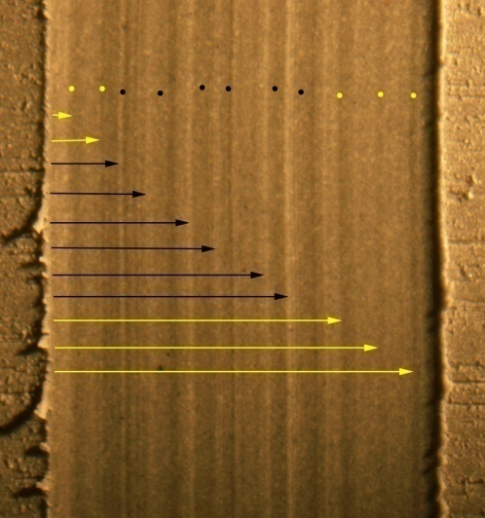
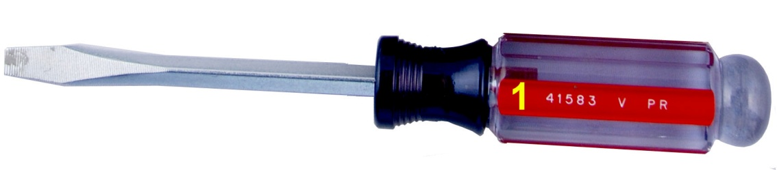
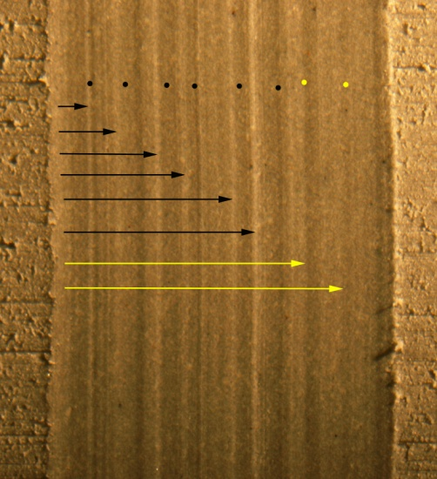
Generate many standard reproducible striation patterns for each screwdriver.
Modeling clay used as impression medium

Slide 5
Measure line/grove positions from edges of patterns
Descritize width of pattern into 0.05 mm increments
In list 140 increments long (7 mm) record 1 if line/grove in a box, 0 otherwise
Gives 140-dimentional feature vectors for each pattern

Slide 6
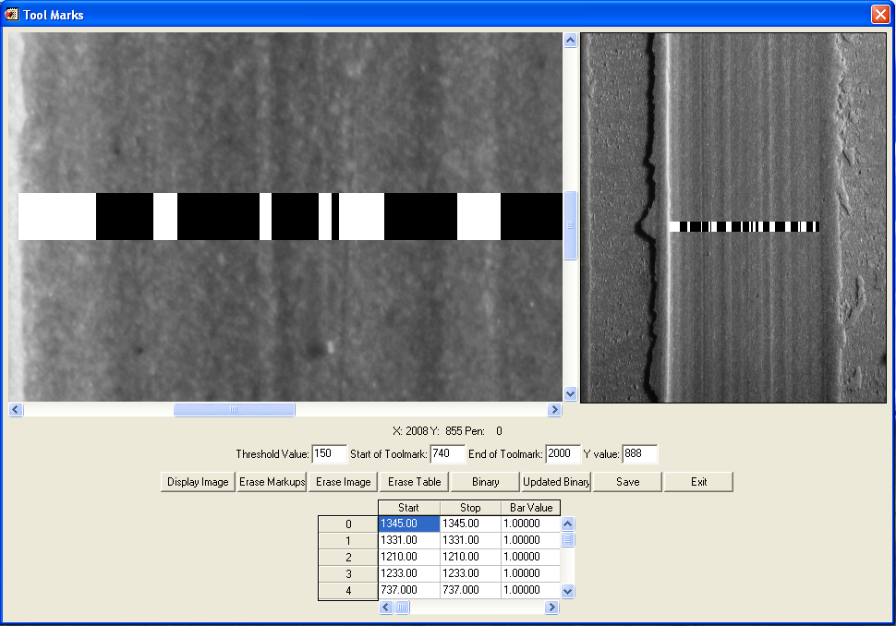
Automated Identification Striations on Digital Images
J. Speir

Slide 7
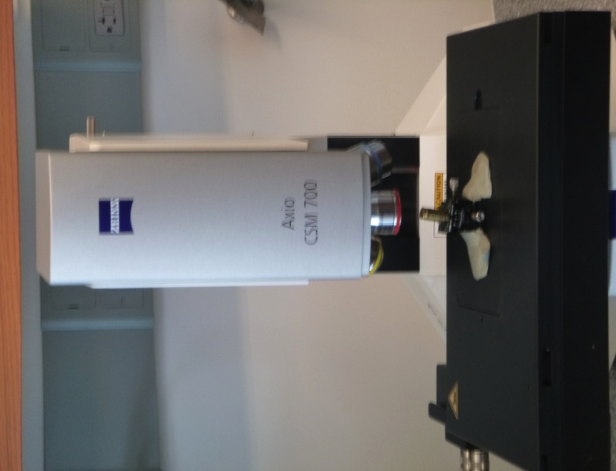
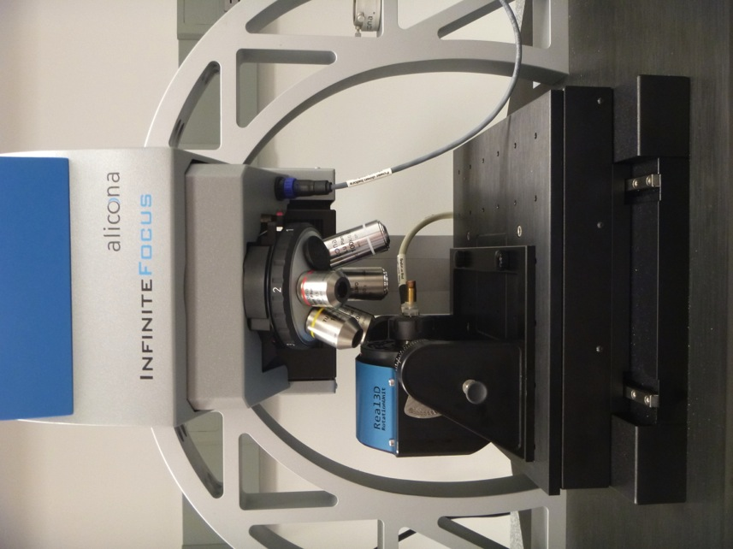
Data Acquisition For Toolmarks
Confocal Microscope
Focus Variation Microscope

Slide 8
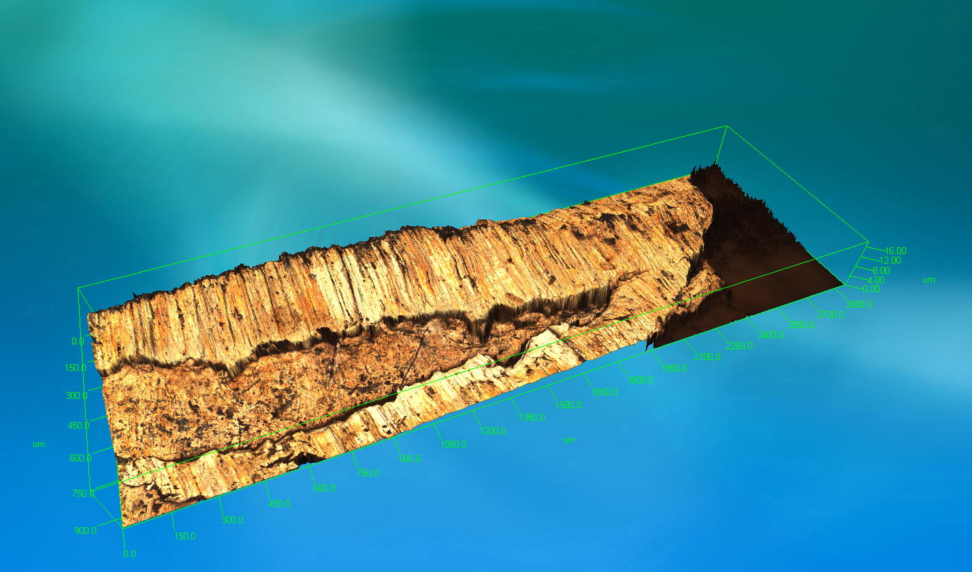
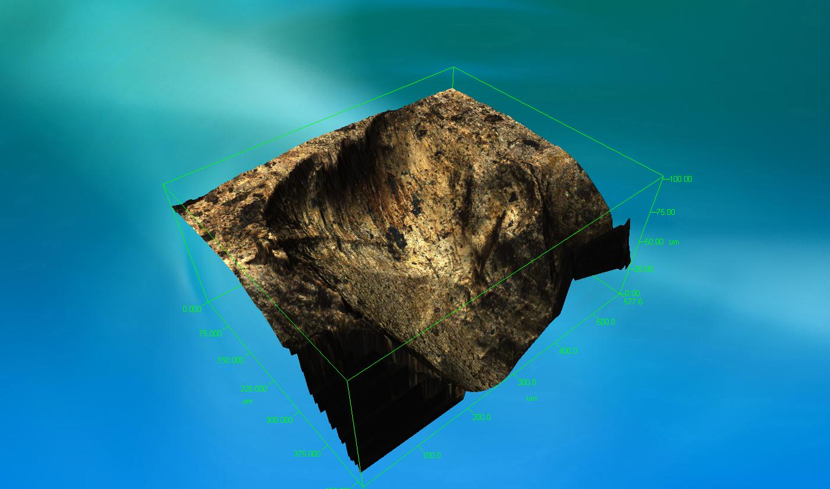
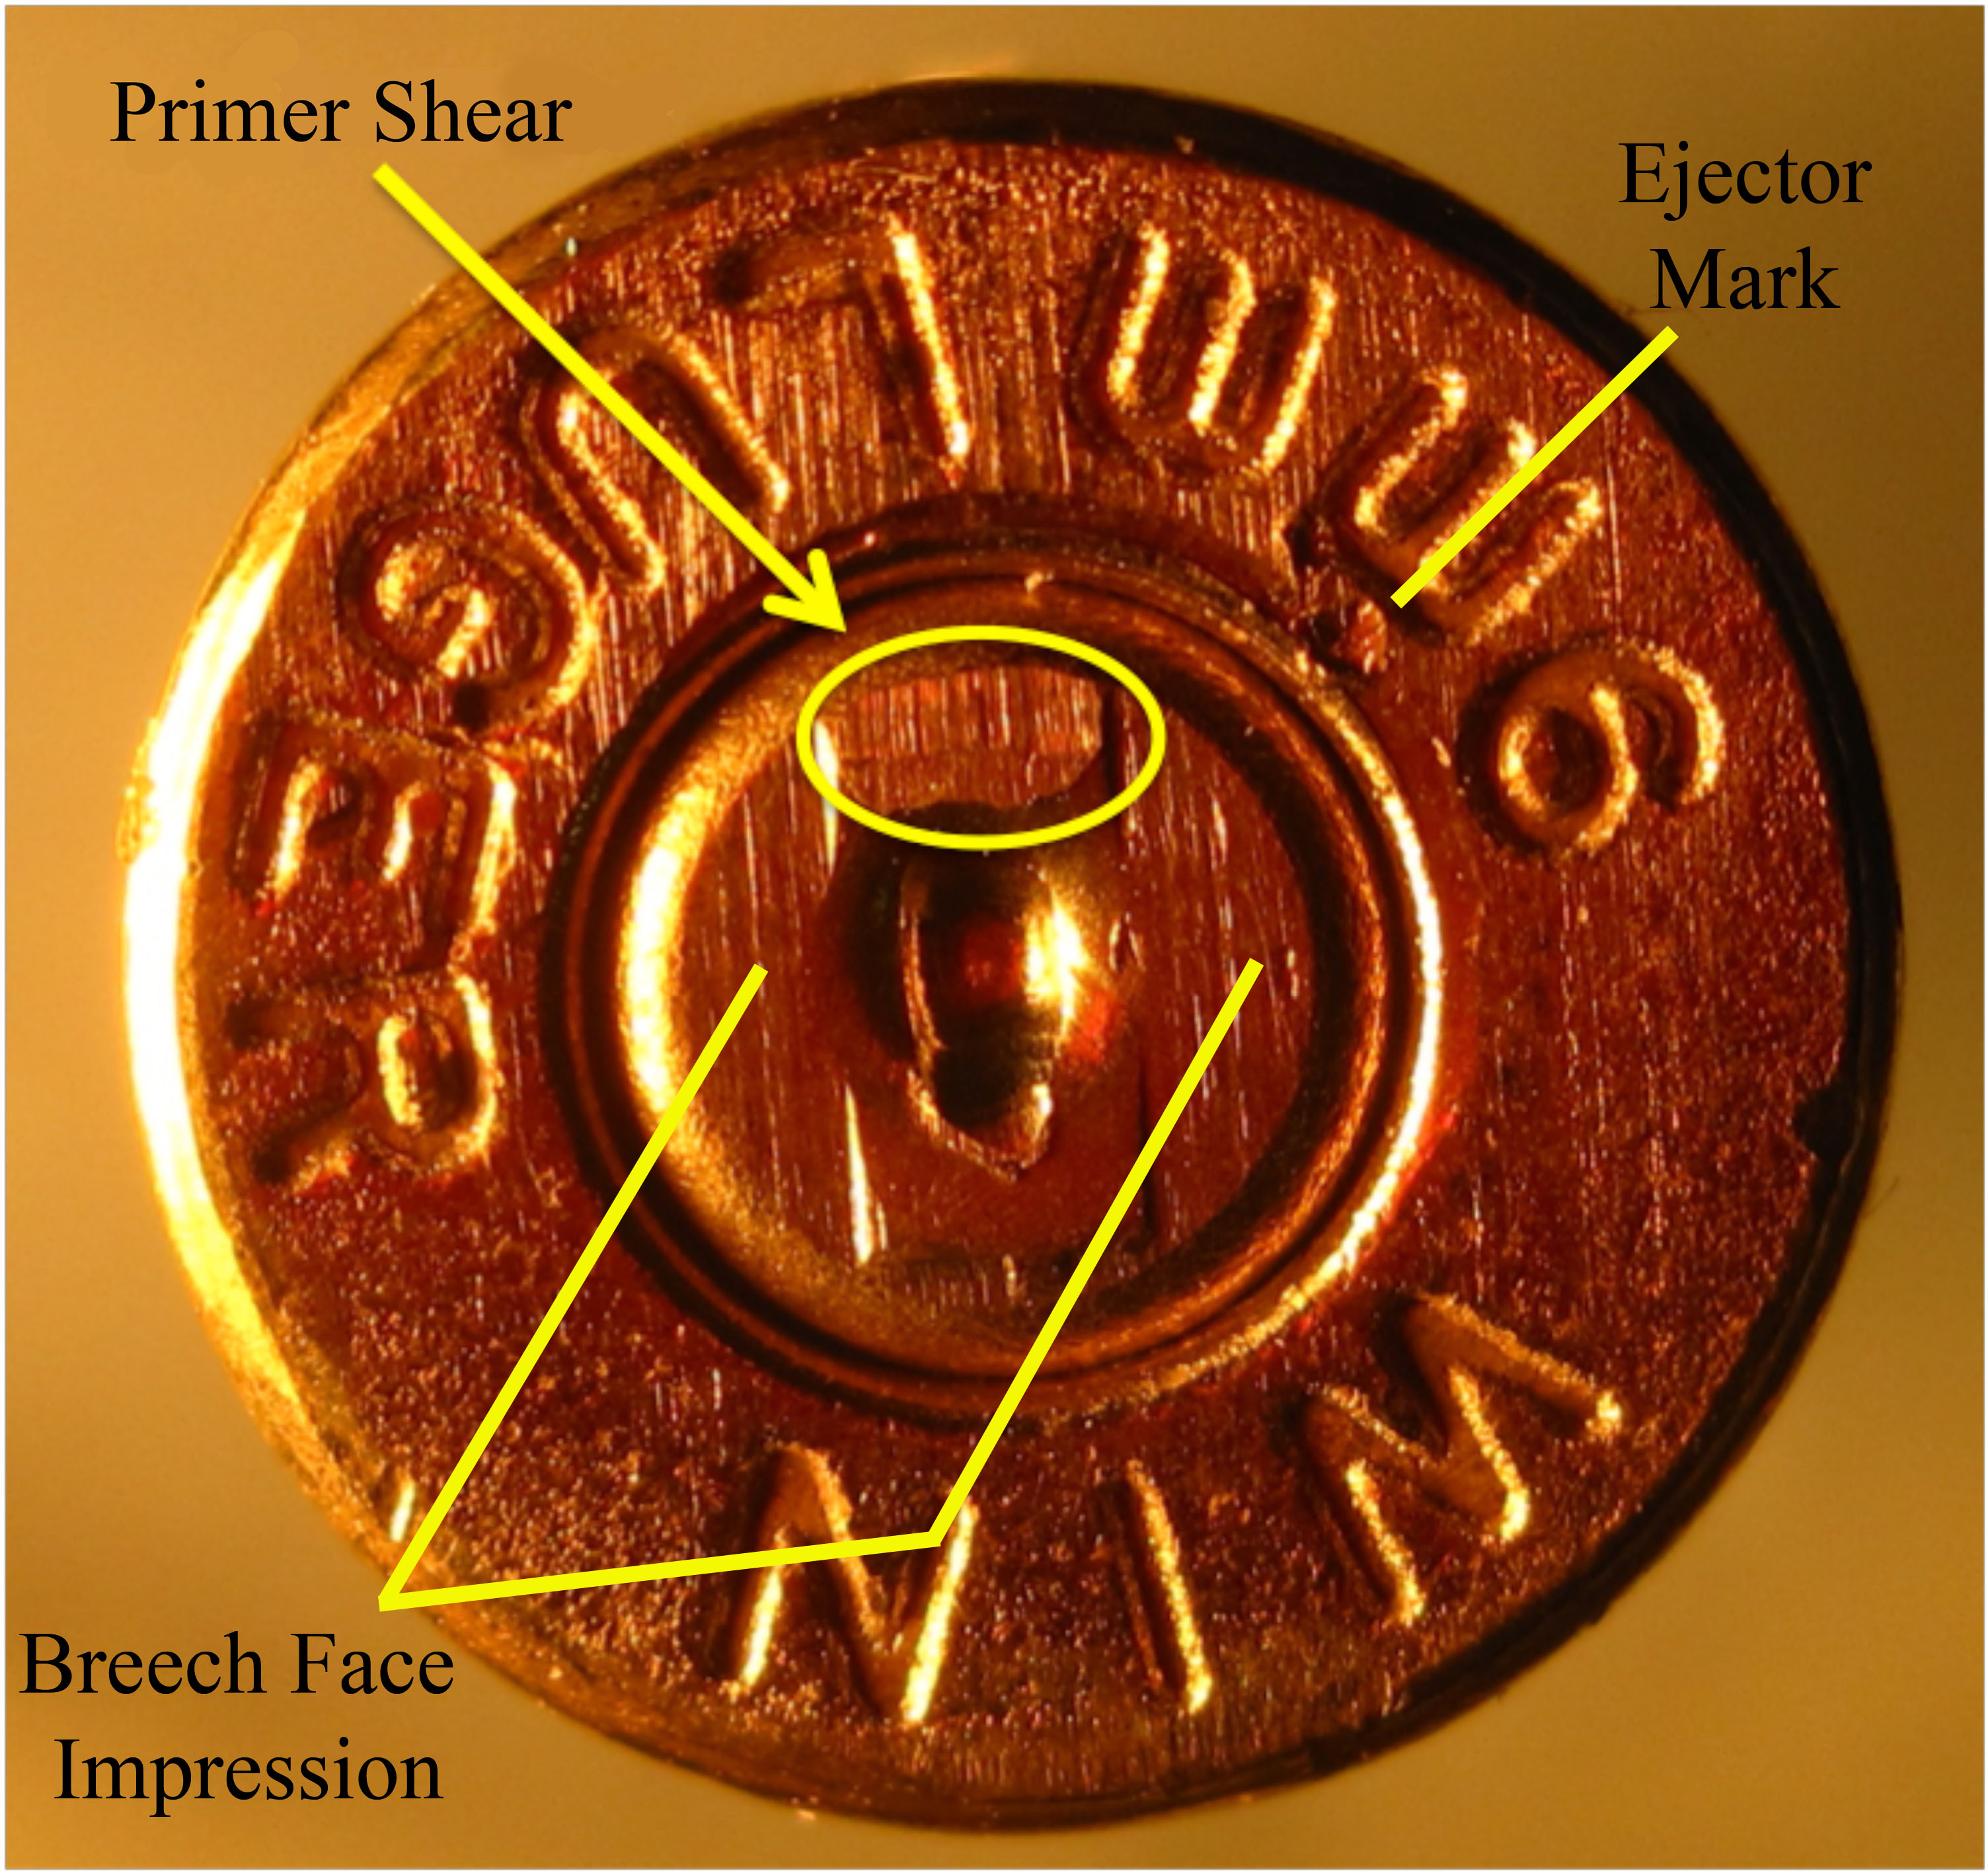
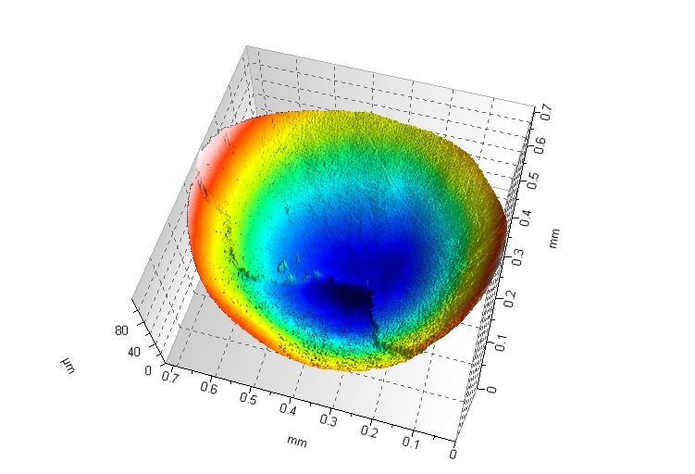
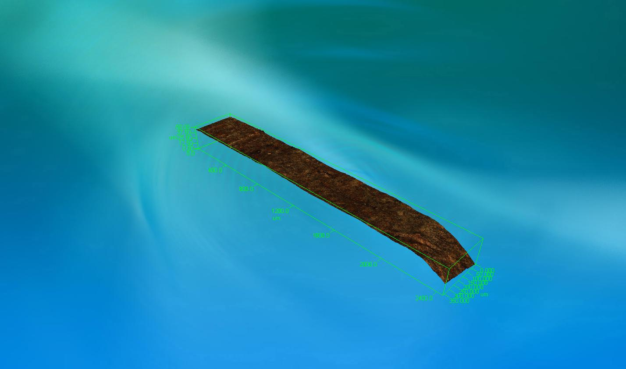
9mm Glock fired cartridge cases
Bottom of
Firing pin imp.

Slide 9
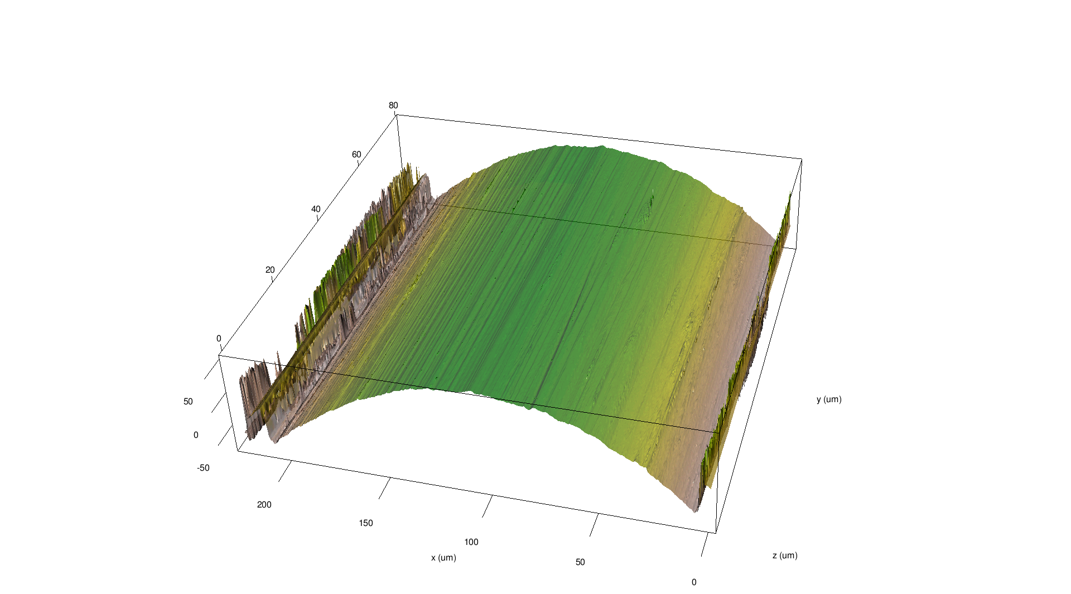
Surface Data
Land Engraved Area:
Surface heights (μm)
37.88 | 37.89 | 37.89 | 37.90 | 37.92 | 37.91 | 37.93 | 37.93 | 37.94 | 37.99
37.88 | 37.89 | 37.87 | 37.87 | 37.87 | 37.85 | 37.89 | 37.92 | 37.97 | 38.02
37.86 | 37.85 | 37.84 | 37.84 | 37.84 | 37.85 | 37.85 | 37.92 | 37.98 | 38.03
37.84 | 37.82 | 37.81 | 37.81 | 37.83 | 37.85 | 37.88 | 37.92 | 37.97 | 38.04
37.81 | 37.80 | 37.80 | 37.82 | 37.84 | 37.86 | 37.89 | 37.94 | 37.98 | 38.05
37.81 | 37.78 | 37.79 | 37.82 | 37.85 | 37.89 | 37.94 | 37.96 | 38.00 | 38.04
37.82 | 37.80 | 37.80 | 37.83 | 37.87 | 37.91 | 37.98 | 37.99 | 38.02 | 38.05
37.84 | 37.81 | 37.80 | 37.81 | 37.84 | 37.89 | 37.95 | 37.99 | 38.01 | 38.06
37.84 | 37.80 | 37.76 | 37.77 | 37.78 | 37.86 | 37.92 | 37.96 | 38.00 | 38.03
37.80 | 37.77 | 37.76 | 37.74 | 37.79 | 37.84 | 37.90 | 37.93 | 37.98 | 38.00
Signal is “double precision”: 64-bits/points sampled at given resolutions

Slide 10
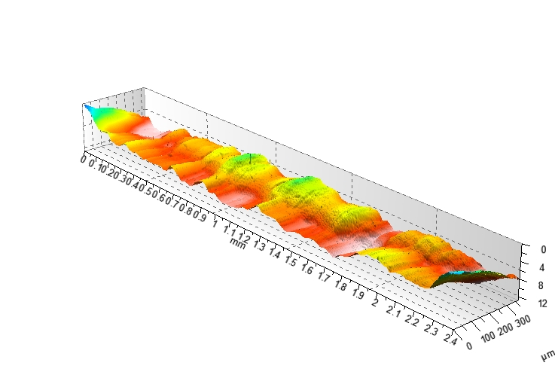
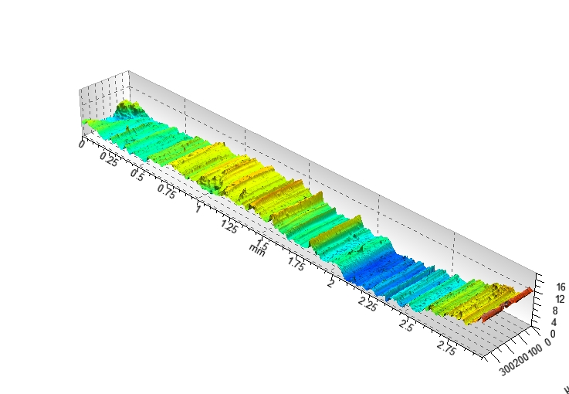
Shear marks on primer of two different Glock 19s

Slide 11
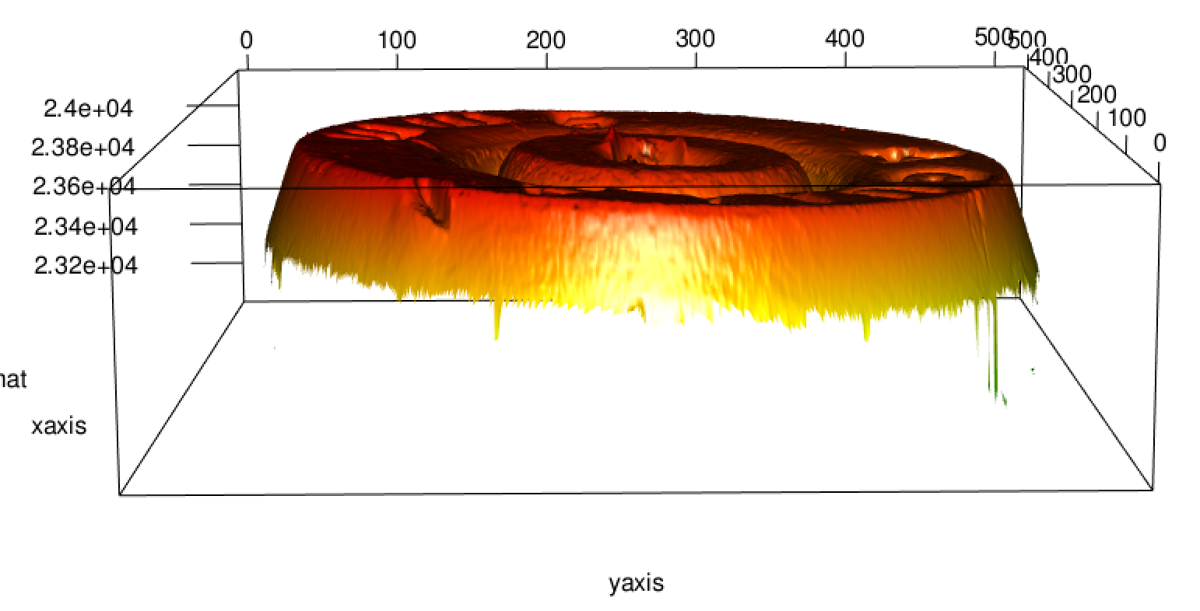
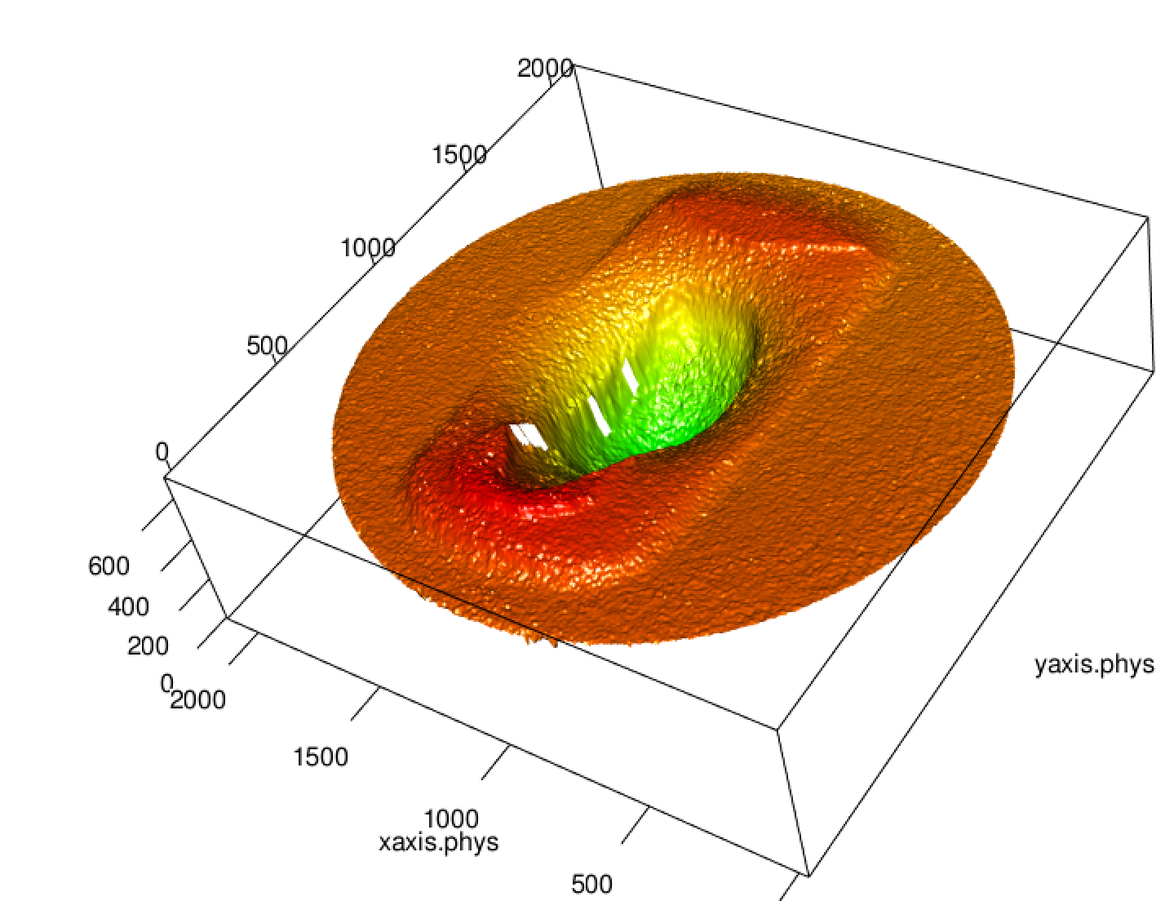
Steps in Processing Surface “Signal” Data
3D tool mark data usually needs (a lot of…) preprocessing
Possibly remove “long range”
behavior (leveling, form removal)
Crop out areas of interest

Slide 12
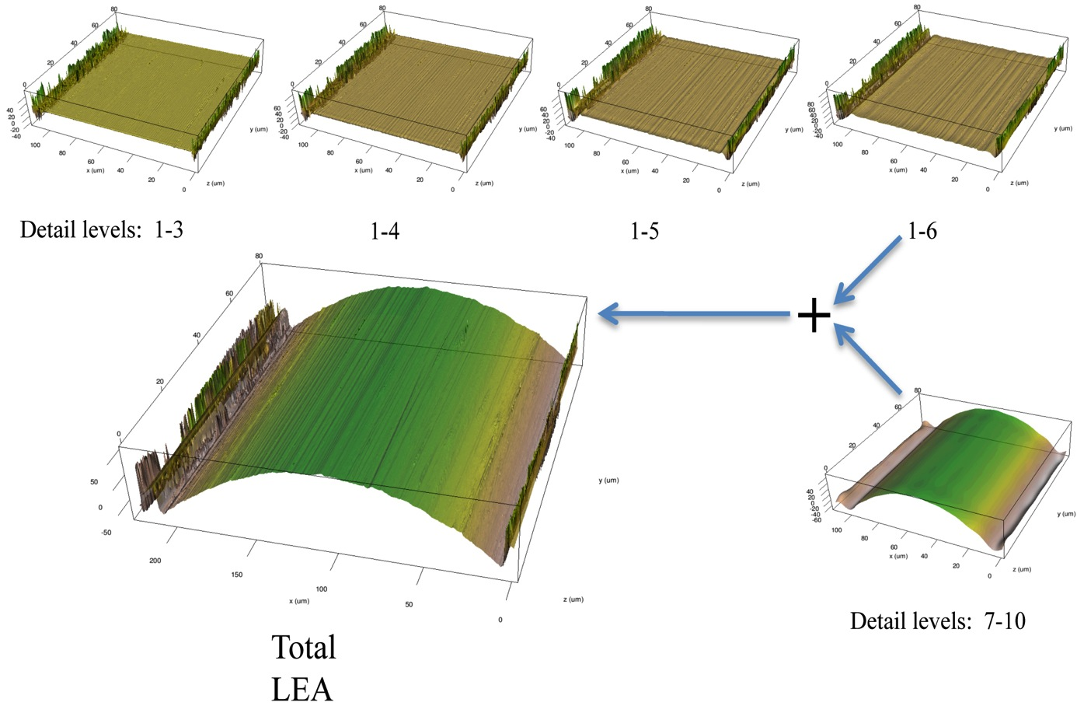
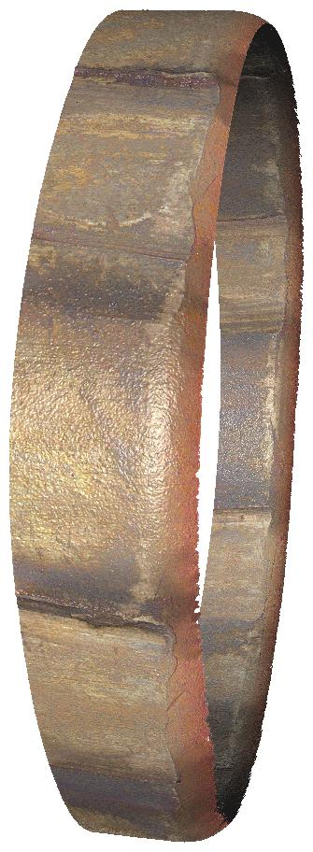
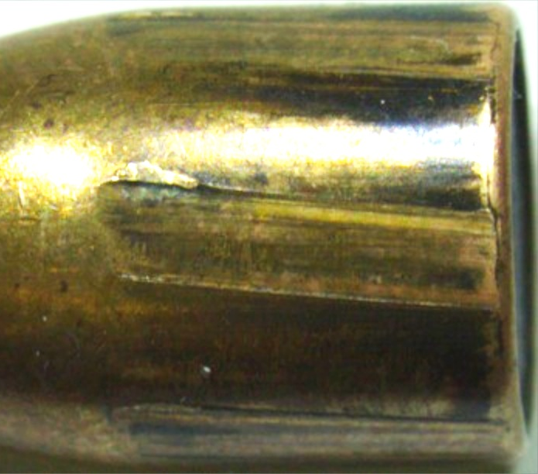
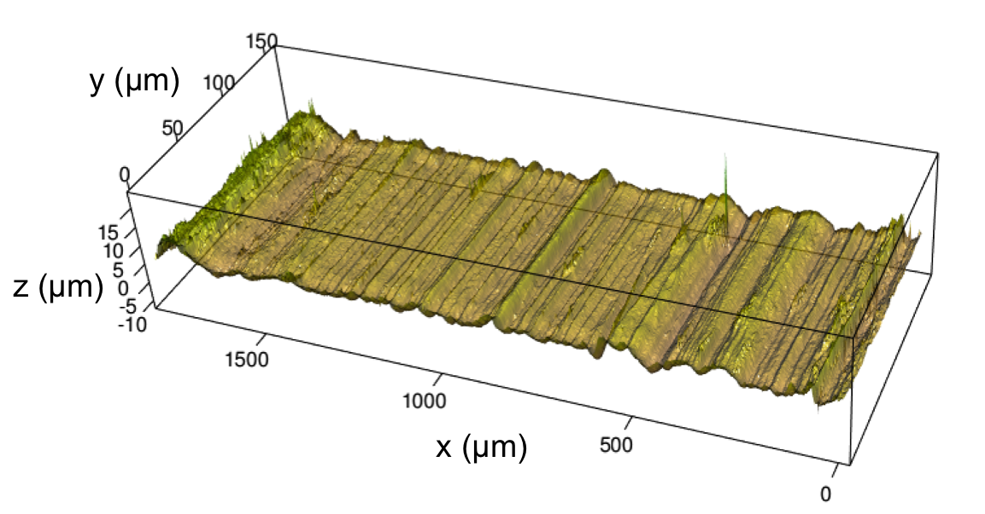
Bullets
LEA
Bullet base, 9mm Ruger Barrel

Slide 13
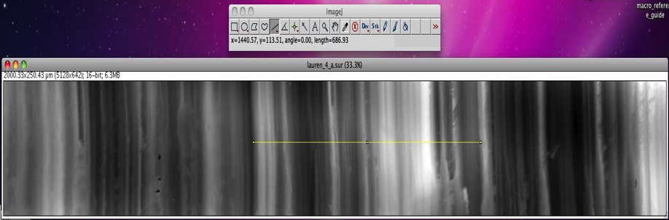
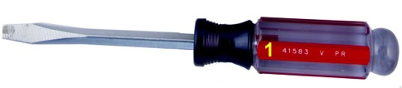
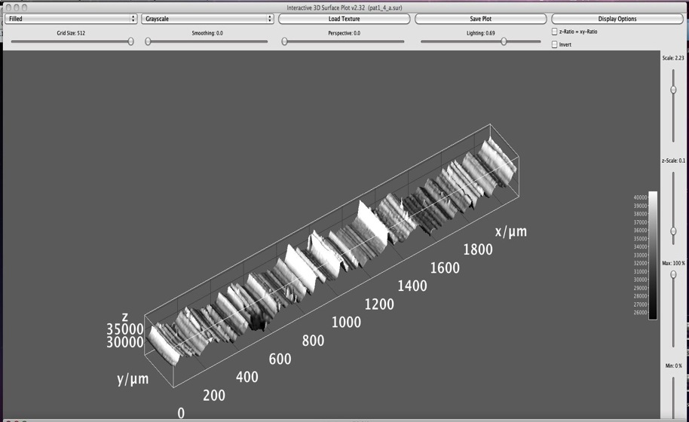
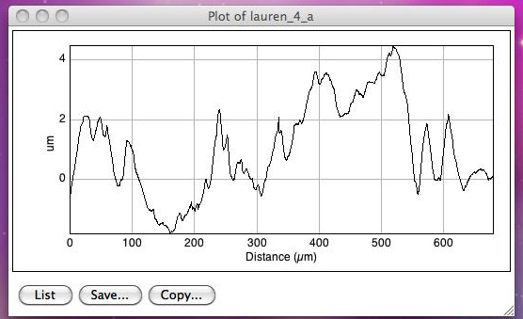
Screwdriver Striation Patterns in Lead
3D surfaces
(interactive)
2D profiles

Slide 14
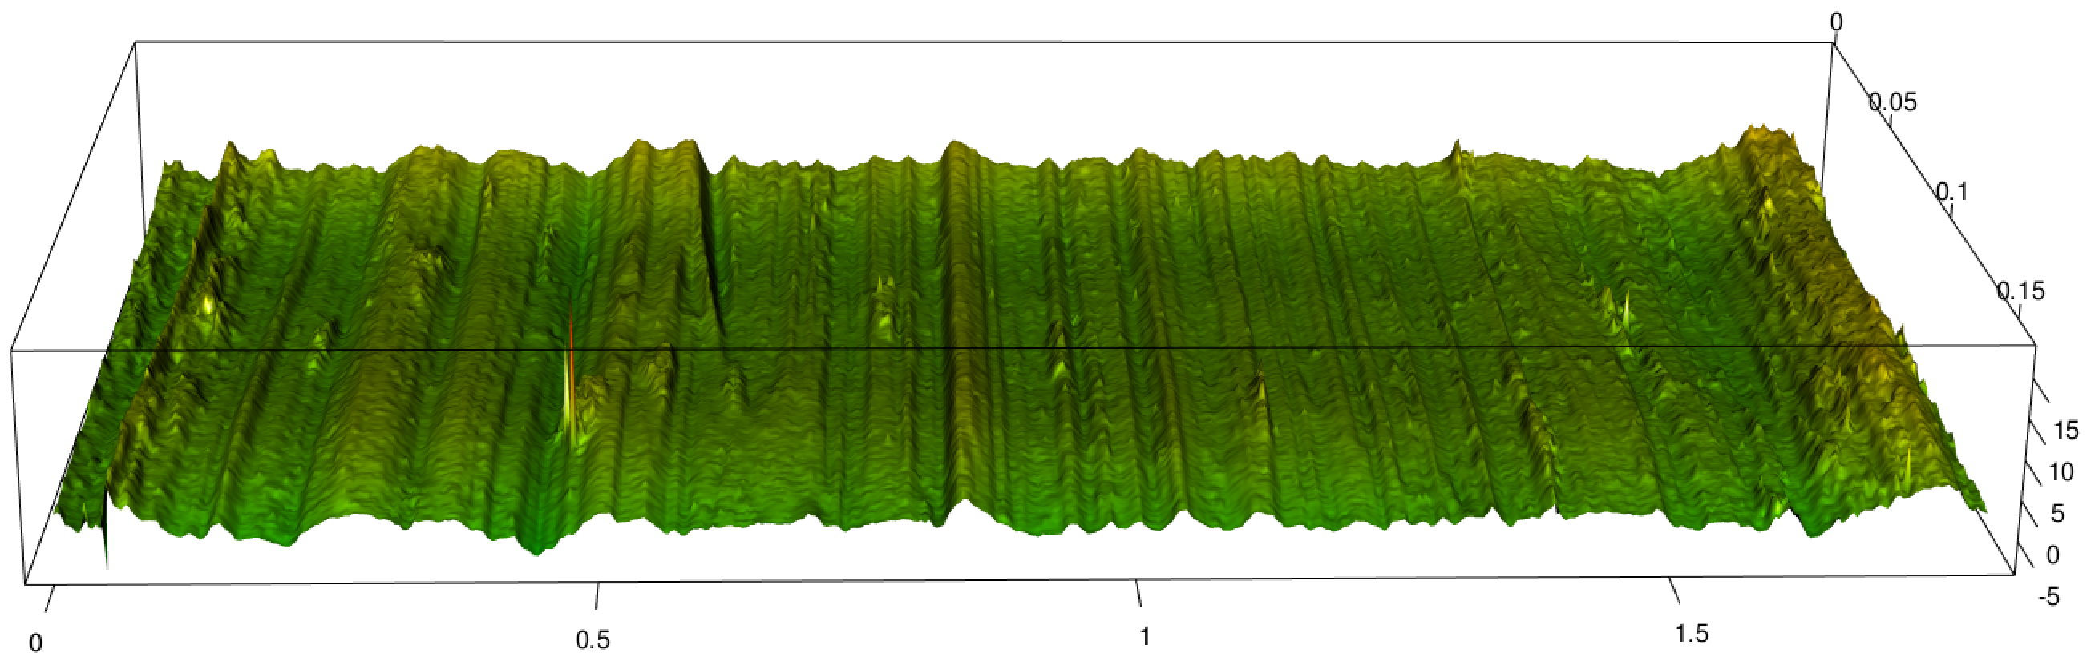
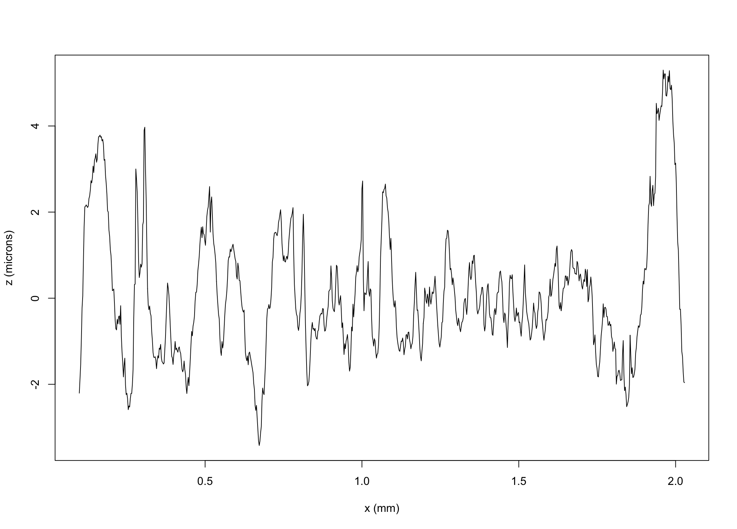

Slide 15
Surface Filtering
Think of a toolmark surface as being made up of a series of waves

Slide 16
Surface Filtering
Examine different scales by “blocking out” (filtering) some of the sinusoids
“Low Pass” filter blocks
high frequencies
and passes low frequencies
(long wavelengths)

Slide 17
Surface Filtering
Examine different scales by “blocking out” (filtering) some of the sinusoids
“High Pass” filter blocks low frequencies
and passes high frequencies
(short wavelengths)

Slide 18
Surface Filtering Trivia
Wavelength “cutoffs”
A “Low Pass” filter
A “High Pass” filter
λcut
λcut
Wavelength ranges
Short wavelengths passed: roughness
Medium wavelengths passed: waviness
Long wavelengths passed: form

Slide 19

Surface Filtering with Wavelets
Band-pass filter: Select narrow wavelength bands to keep.
High-pass/Low-pass combinations (Filter banks)
Wavelets are great at doing this

Slide 20
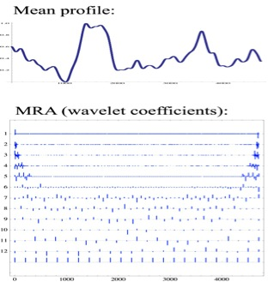
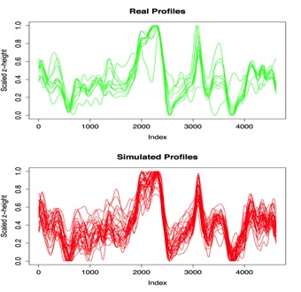
Profile Simulator
We can simulate profiles as well
Based on DWT MRA
May shed light on the processes which generate the surfaces

Slide 21
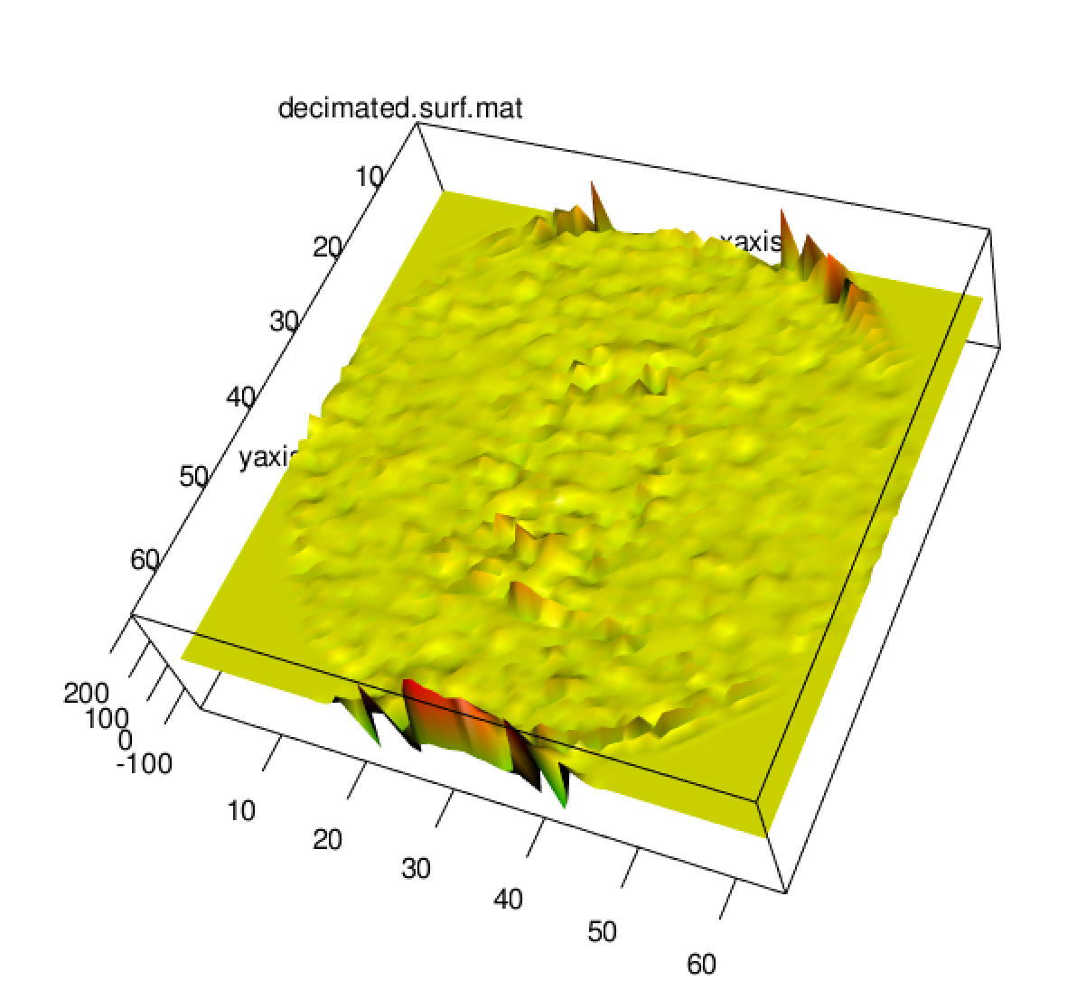
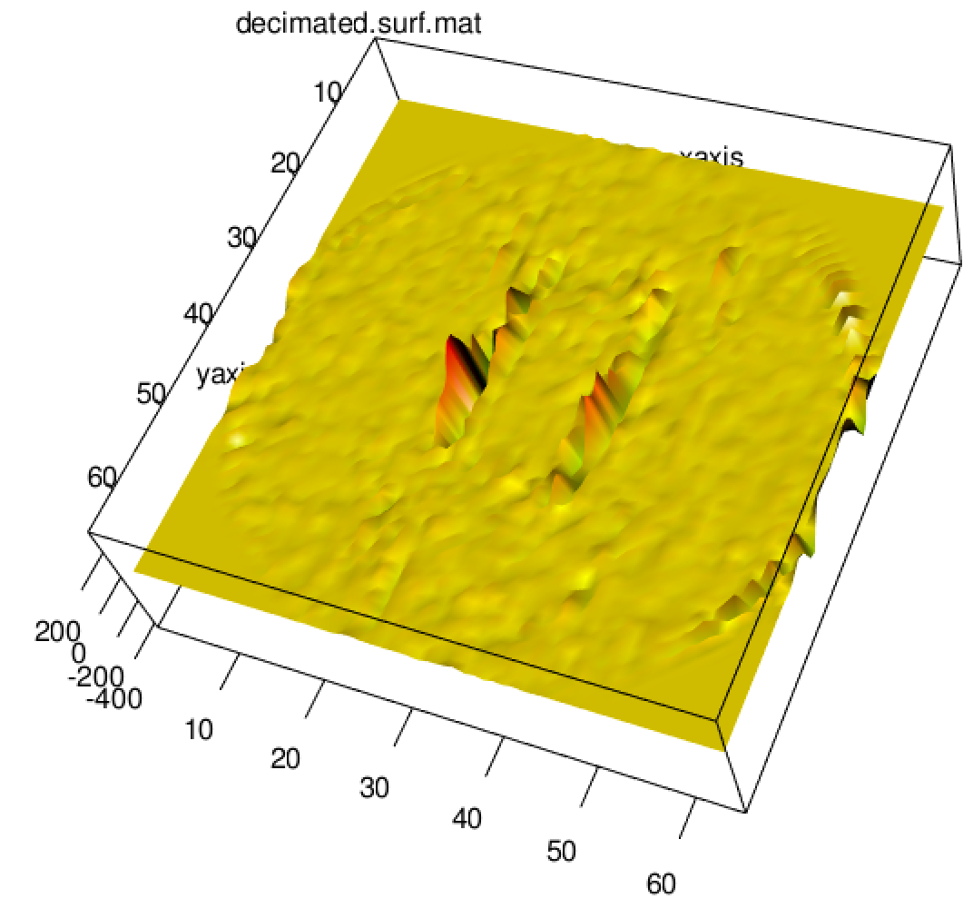
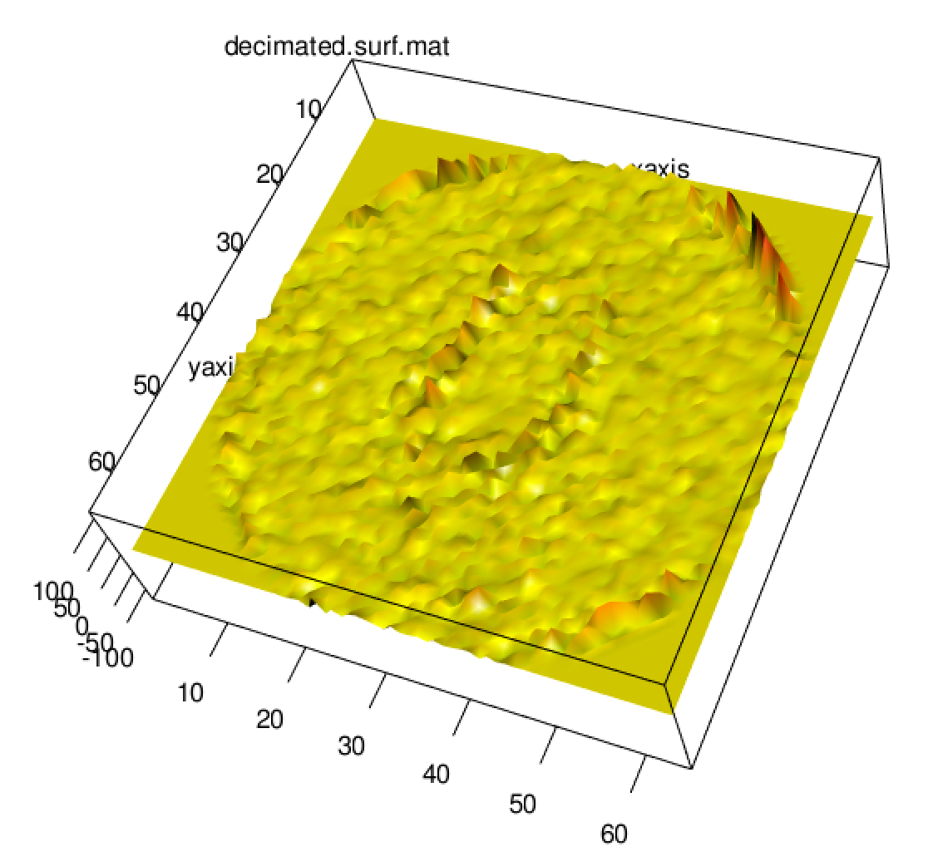
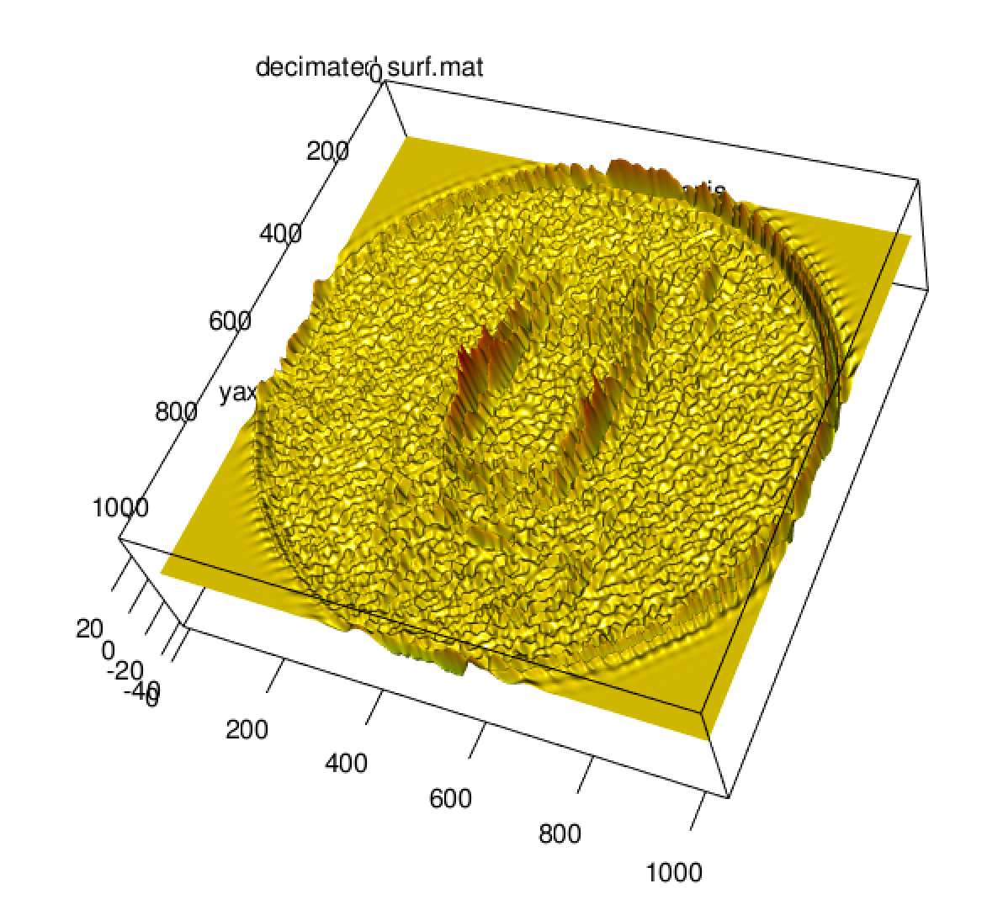
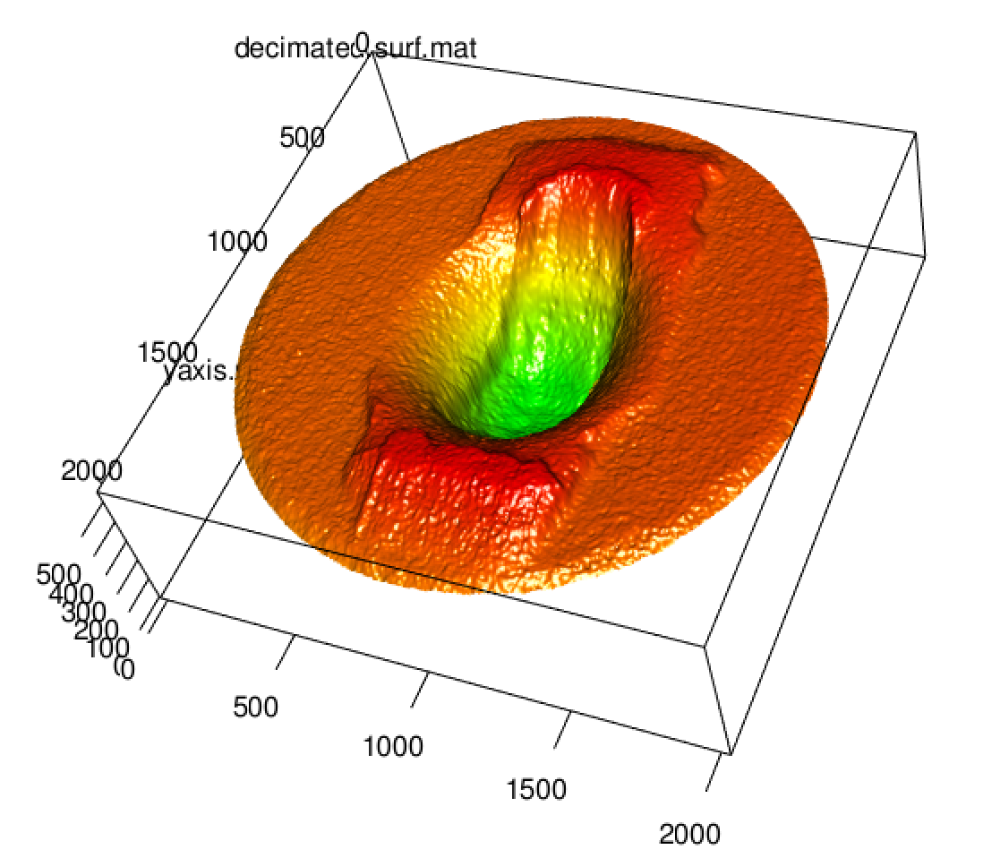
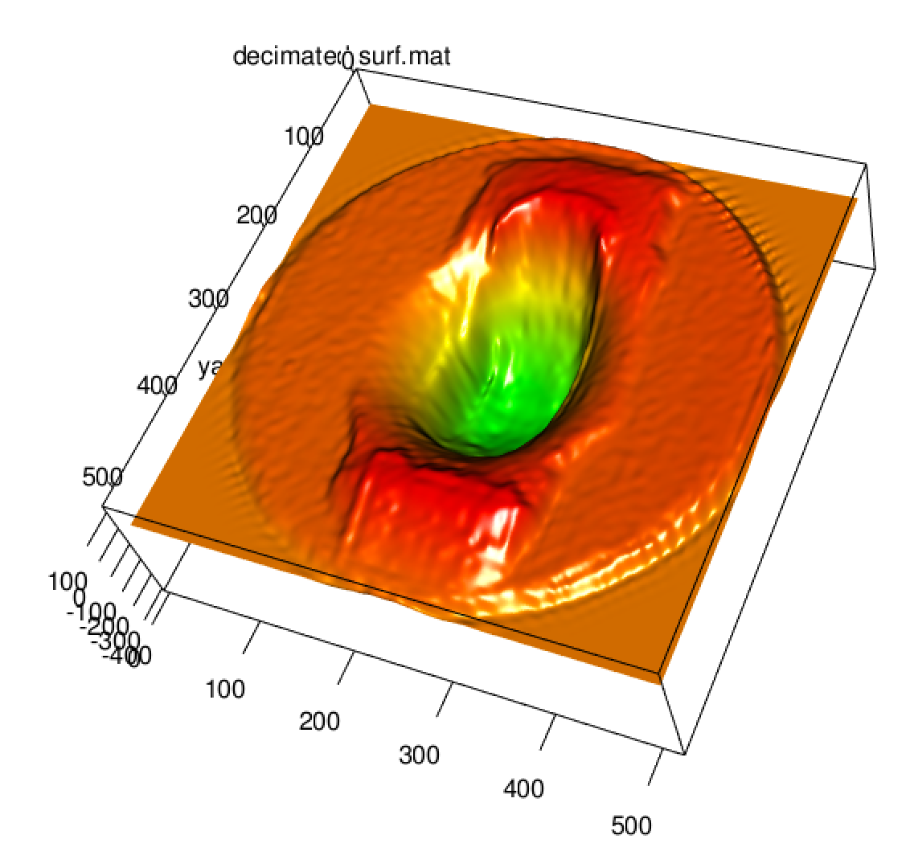
2D Simulations with Wavelets
Wavelet based simulator for 2D toolmarks:
LH4
Simulate stochastic detail
HL4
HH4
+

Slide 22
How to Compare Signals?
Gauge similarity between tool marks with one number
Similarity “metric” is a function which measures “sameness”
Only requirement: s(A,B) = s(B,A)
There are an INFINITE number of ways to measure similarity!!
Often max CCF is used.

Slide 23
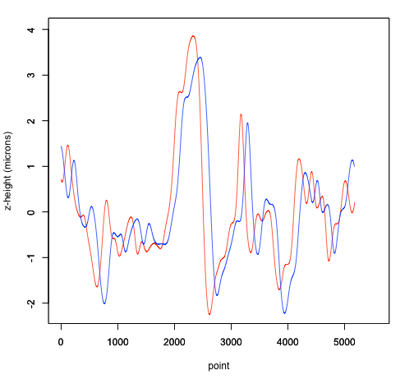
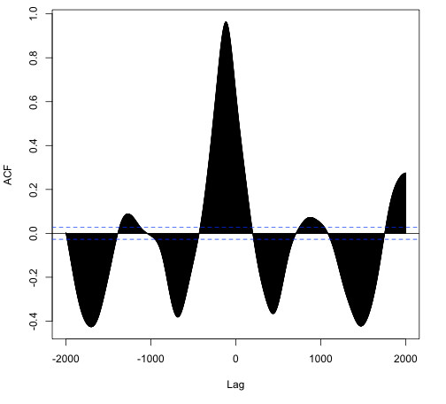
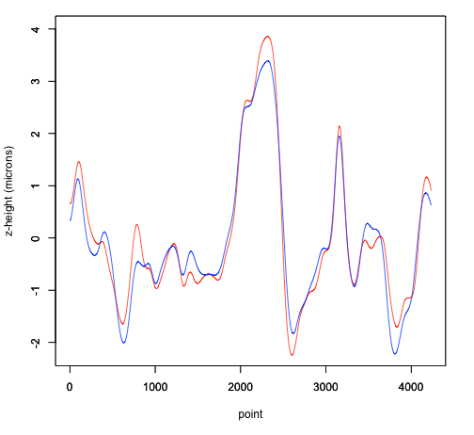
Known Match (KM) example:

Slide 24
KNM can sometimes have high max-ccf…
max-ccf: 0.751

Slide 25
Pair-Wise Comparisons
Univariate approaches compute estimates of similarity score distributions for Known Matches (KM) and Known Non-Matches (KNM)
KNM similarity score distribution
KM similarity score distribution
Cut-off
Call: Non-Matches
Call: Matches
#False Non-matches/#KM-Comparisons = FNMR
#False Matches/#KNM-Comparisons = FMR
Error rate = (#False Non-matches + #False Matches)/#Comparisons

Slide 26
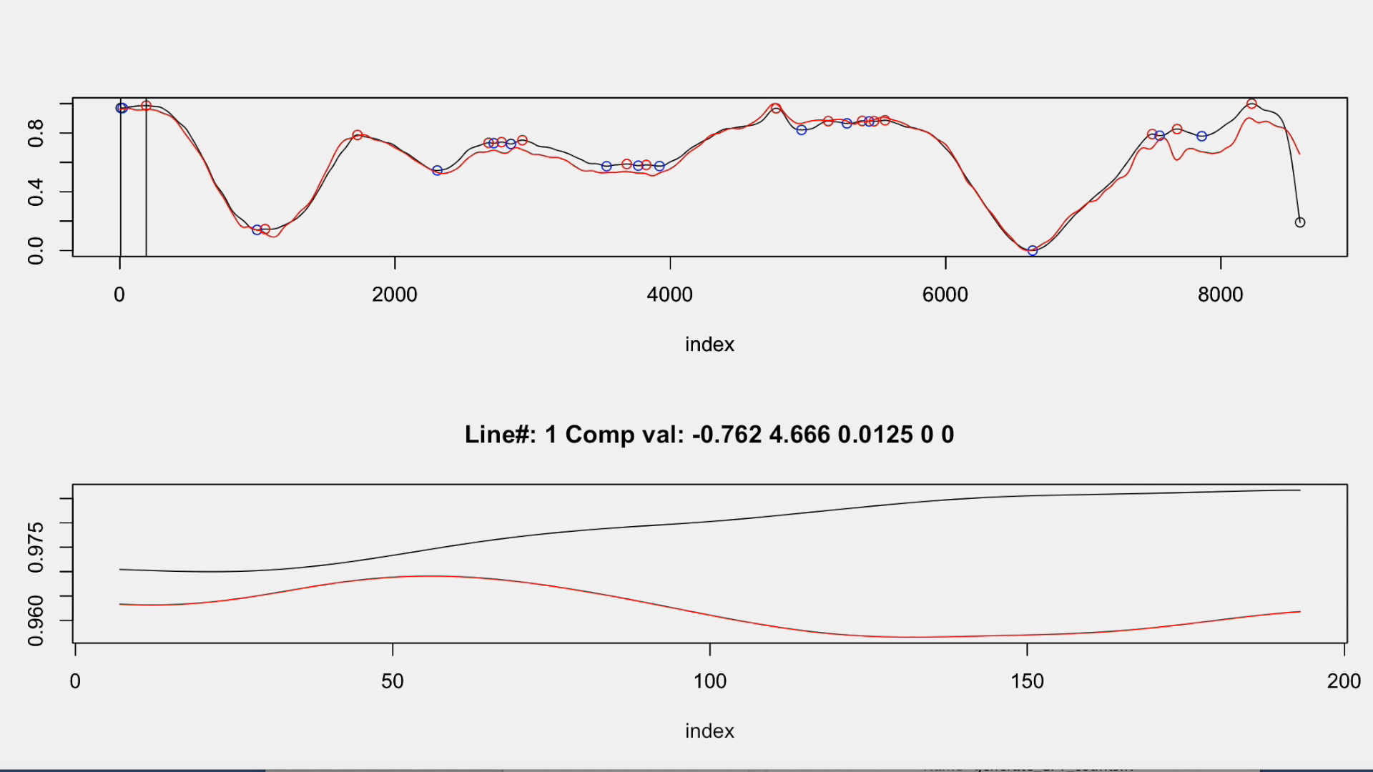
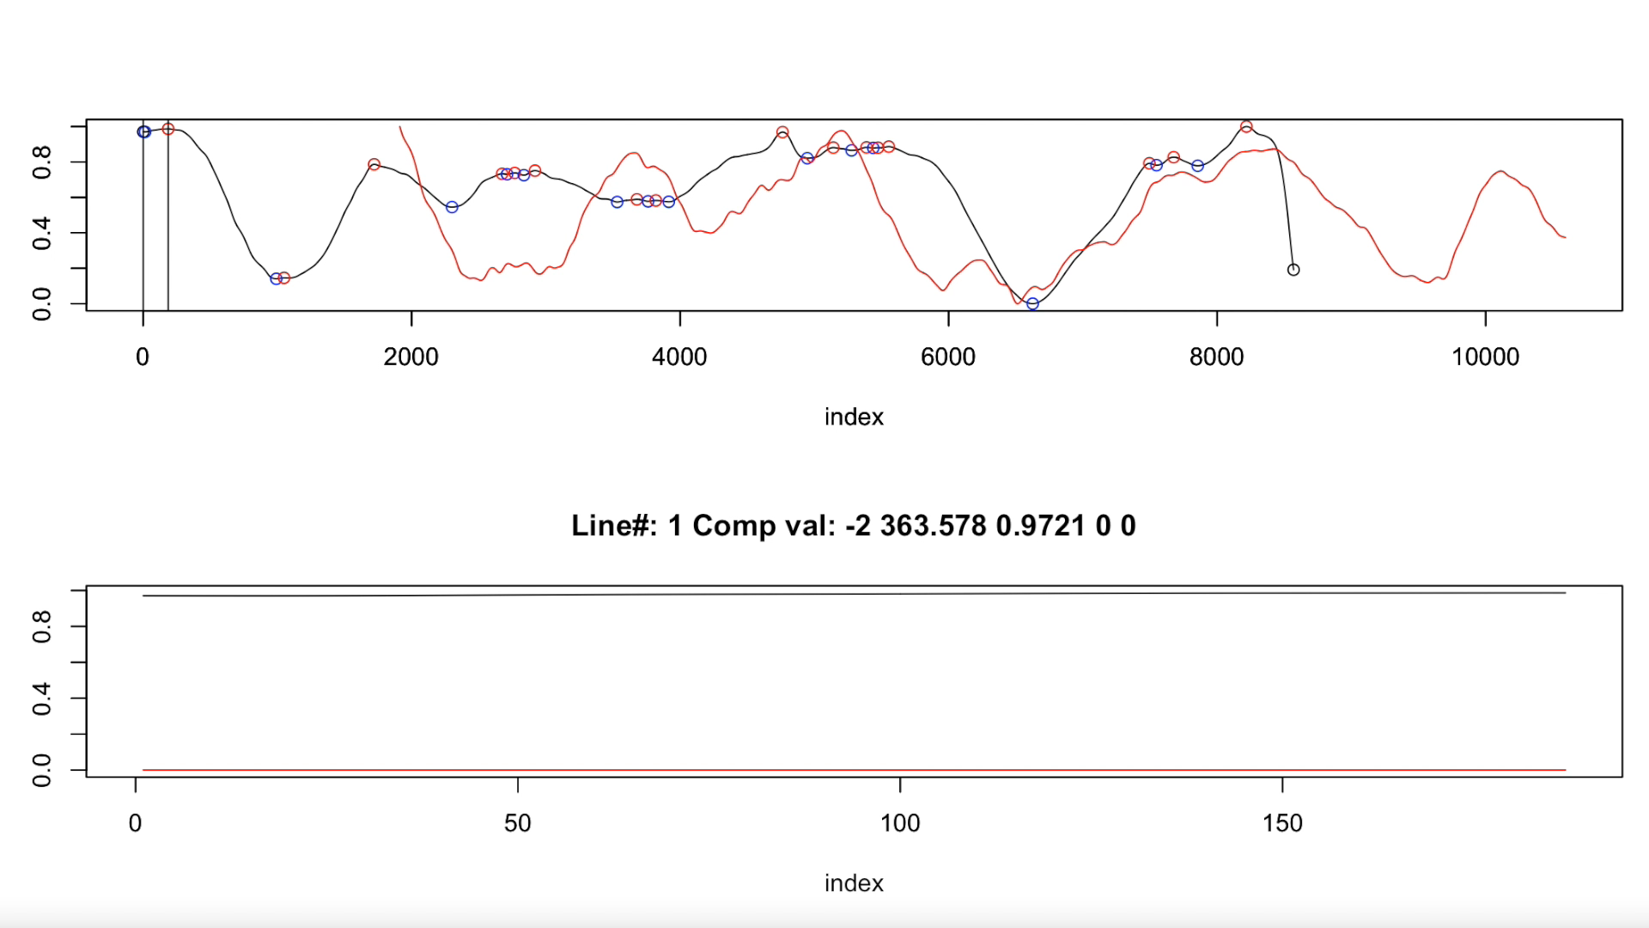
KM1
KM2
KM matching lines
and scores
Compare “lines” KM1 vs. KM2
KNM1=KM1
KNM2
KNM matching lines
and scores
Compare “lines” KNM1 vs. KNM2

Slide 27
Take a representative for a group of tool marks
made by the same tool as a “chapter” in a “dictionary”
A tool mark is a “word” in a chapter.
A line is a “letter” in a “word”

Slide 28
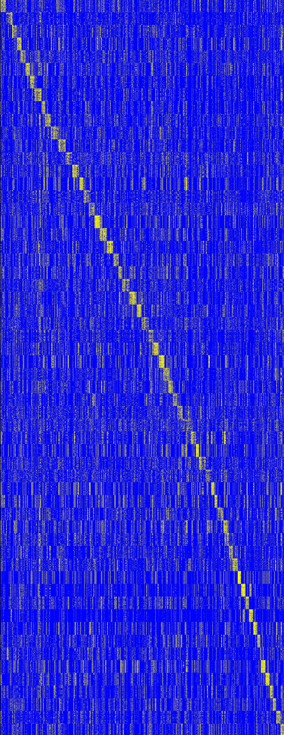
Consecutive Matching Striae (CMS)-Space
Biasotti-Murdock Dictionary
(58 “chapters”)
1740 Toolmarks (screwdriver striation profiles)
from database and simulation

Slide 29
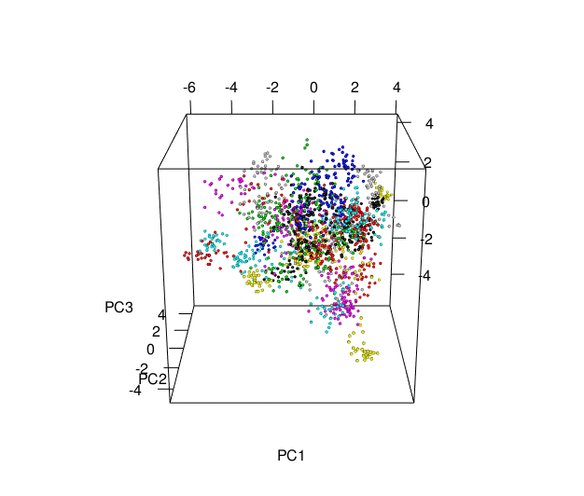
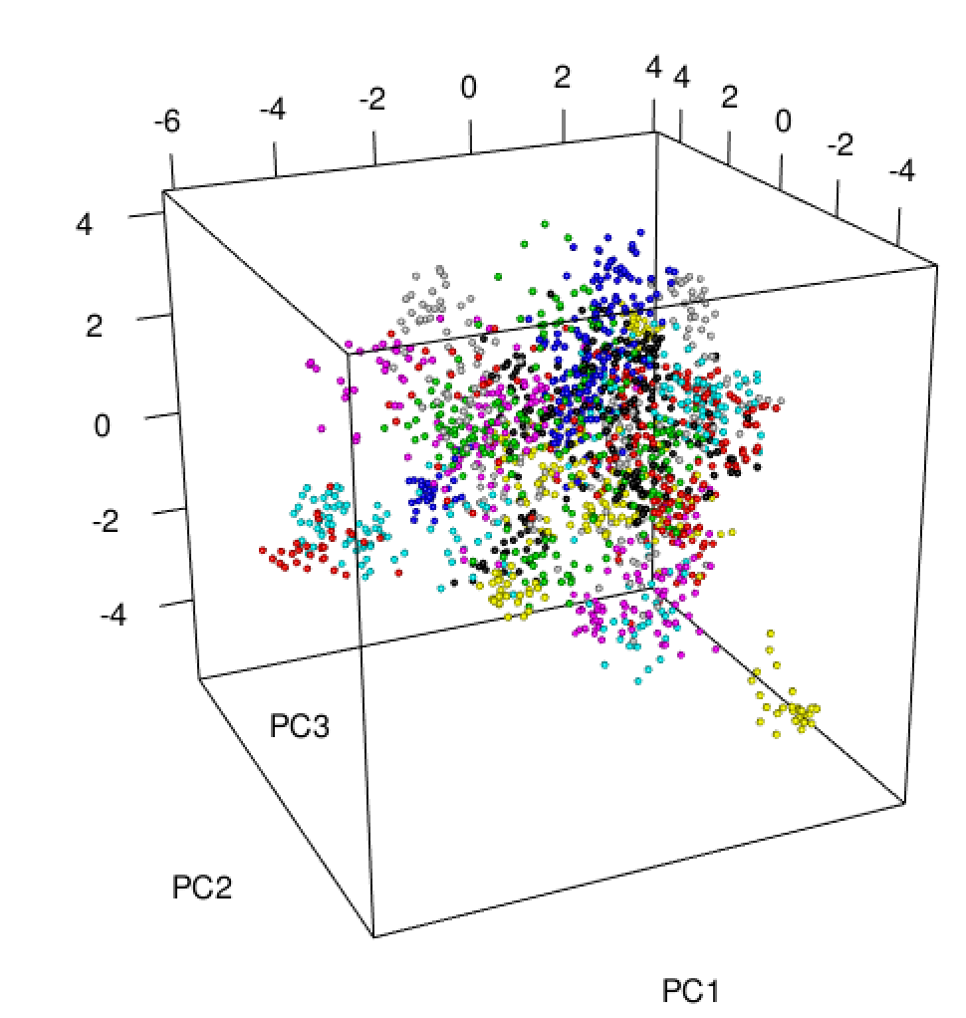

3D PCA of 1740 real and simulated Biasotti-Murdock’d striation patterns from 58 screwdrivers:
How many PCs should we use to represent the data??
No unique answer
FIRST we need an algorithm to I.D. a toolmark to a tool
~9% variance retained

Slide 30
Support Vector Machines
Support Vector Machines (SVM) determine efficient association rules
In the absence of specific knowledge of probability densities
SVM decision boundary

Slide 31
PCA-SVM
How many Principal Components should we use?
With 7 PCs, expect ~3% error rate
With 13 PCs, expect ~1% error rate

Slide 32
Error Rate Estimation
Cross-Validation: hold-out chunks of data set for testing
Known since 1940s
Most common: Hold-one-out
Bootstrap: Randomly selection of observed data (with replacement)
Known since the 1970s
Can yield confidence intervals around error rate estimate
The Best: Small training set, BIG test set

Slide 33
How good of a “match” is it?
Conformal Prediction^{Vovk}
Can give a judge or jury an easy to understand measure of reliability of classification result
Confidence on a scale of 0%-100%
Testable claim: Long run I.D. error-rate should be the chosen significance level
80% confidence
20% error
Slope = 0.2
This is an orthodox “frequentist”
approach
Roots in Algorithmic Information Theory
Cumulative # of Errors
95% confidence
5% error
Slope = 0.05
99% confidence
1% error
Slope = 0.01
Data should be IID but that’s it
Sequence of Unk Obs Vects

Slide 34
Conformal Prediction
For 95%-CPT (PCA-SVM) confidence intervals will not contain the correct I.D. 5% of the time in the long run
Straight-forward validation/explanation picture for court
Empirical Error Rate: 5.3%
Theoretical (Long Run)
Error Rate: 5%
14D PCA-SVM Decision Model
for screwdriver striation patterns

Slide 35
How good of a “match” is it?
Efron Empirical Bayes
An I.D. is output for each questioned tool mark
This is a computer “match”
What’s the probability the tool is truly the source of the tool mark?
Similar problem in genomics for detecting disease from microarray data
They use data and Bayes’ theorem to get an estimate

Slide 36
Empirical Bayes
From Bayes’ Theorem we can get^{Efron}:
Estimated probability of not a true “match” given the algorithms' output z-score associated with its “match”
Names: Posterior error probability (PEP)^{Kall}
Local false discovery rate (lfdr)^{Efron}
Suggested interpretation for casework:
= Estimated “believability” that the specific tool
produced the tool mark

Slide 37
Fit local-fdr models
z
z
Use locfdr^{locfdr}
Fit classic Poisson regression for f(z)
Use modified locfdr/JAGS^{JAGS,Plummer} or Stan^{Stan}
Fit Bayesian hierarchical Poisson regressions

Slide 38
A Bayesian Hierarchical Model: Believability Curve
95% HPDI
“uncertainty bands”
JAGS MCMC Bayesian over-dispersed Poisson with intercept, on test set

Slide 39
Empirical Bayes’
Model’s use with crime scene “unknowns”:
This is an uncertainty in the estimate
This is the est. post. prob. of no association = 0.00027 = 0.027%
Computer outputs “match” for:
unknown crime scene toolmarks-with knowns from “Bob the burglar” tools

Slide 40

Why ?
R is not a black box!
Codes available for review; totally transparent!
R maintained by a professional group of statisticians, and computational scientists
From very simple to state-of-the-art procedures available
Very good graphics for exhibits and papers
R is extensible (it is a full scripting language)
Coding/syntax similar to MATLAB
Easy to link to C/C++ routines

Slide 41
Why ?
Where to get information on R :
R: http://www.r-project.org/
Just need the base
RStudio: http://rstudio.org/
A great IDE for R
Work on all platforms
Sometimes slows down performance…
CRAN: http://cran.r-project.org/
Library repository for R
Click on Search on the left of the website to search for package/info on packages

Slide 42
Finding our way around R/RStudio

